Slide 1





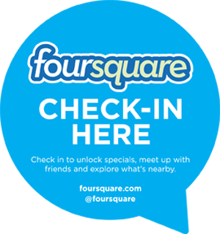





ANALYTICS FOR UNSTRUCTURED DATA Sentiment Analysis MSBA Fall 2023 5th September
Dr. Anitesh Barua
David Bruton Jr. Centennial Chair Professor of Business
Distinguished Fellow, INFORMS Information Systems Society
Stevens Piper Foundation Professor
University of Texas Distinguished Teaching Professor
McCombs School of Business, University of Texas at Austin
Email: anitesh.barua@mccombs.utexas.edu

Slide 2


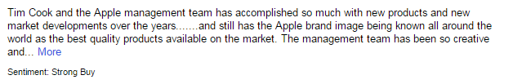
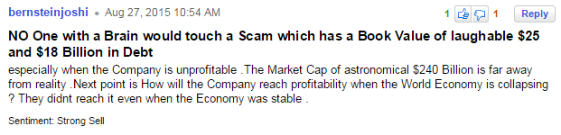
Incorporating Sentiments & Mentions in the Stock Returns Model
Do message sentiments improve prediction of returns?
How about news items?
Training data for stock sentiments

Slide 3
Predicting Stock Returns (the Trillion $ Question): Do Sentiments Matter?
Capital Asset Pricing Model (CAPM)
Fama-French factors
Return on an asset
r = R_{f} + β.(K_{m} – R_{f}) + b_{s}.SMB + b_{v}.HML + α
R_{f}: risk free rate, K_{m}: Return of market portfolio
SMB: Small (market cap) minus big
HML: High (book-to-mkt) minus low
Addition of momentum (Up minus Down) factor

Slide 4
Supervised Sentiment Analysis
Same as classification or prediction with text
Start with a collection of documents whose sentiments are known (i.e., they have been labeled manually or otherwise)
Many approaches are possible – from the naïve to the sophisticated
Unigrams or “bag-of-words” for starters – single words, assumed to occur independently of each other in a document

Slide 5
Simplest Approach to Sentiment Analysis?
“It’s rather like a lifetime special – pleasant, sweet and forgettable.”
Positive reviews in
training data: 15 occurrences
Negative reviews: 6
Goodness score:
Badness score:
Positive: 46
Negative: 22
Goodness score:
Badness score:
Positive: 10
Negative: 14
Goodness score:
Badness score:
Positive: 506
Negative: 507
Goodness score:
Badness score:
Source: https://www.youtube.com/watch?v=0JsHvXmU0dA

Slide 6
Calculations
Words | #Positive | #Negative | Goodness | Badness
it’s | 506 | 507 | .5 | .5
rather | 42 | 63 | .4 | .6
like | 242 | 396 | .61 | .39
a | 3446 | 3112 | .53 | .47
lifetime | 3 | 5 | .38 | .62
special | 29 | 40 | .42 | .58
sweet | 15 | 6 | .71 | .29
pleasant | 46 | 22 | .68 | .32
and | 3198 | 2371 | .57 | .43
forgettable | 10 | 14 | .42 | .58
SCORE |  |  | 5.22 | 4.8

Slide 7
Top-10 Words
Positive | Negative
riveting | unfunny
gem | badly
engrossing | poorly
vividly | flat
wonderfully | bore
polished | pointless
lively | offensive
heartwarming | plodding
startling | product
spare | disguise
Source: https://www.youtube.com/watch?v=0JsHvXmU0dA

Slide 8
Tough to Detect
This movie makes Catwoman look like a great movie
A terrible movie that some people will nevertheless find very moving
Well made but mush-hearted
Your children will be occupied for 72 minutes
Source: https://www.youtube.com/watch?v=0JsHvXmU0dA

Slide 9
K-Nearest Neighbors
Instead of comparing individual words in the training set, consider entire reviews.
Find “nearest” reviews
Example
Classify as positive or negative:
“It’s rather like a lifetime special – pleasant, sweet and forgettable”
Find “most similar” review(s) in the training set
“I liked this movie, made for a pleasant evening” (Class = positive)
“This movie was such a bore” (Class = negative)
Source: https://www.youtube.com/watch?v=0JsHvXmU0dA

Slide 10
The Difference
BEFORE
NOW
it’s
sweet
it’s
sweet
special
special
rather
pleasant
rather
pleasant
compare
TRAINING SET
BAGS
Source: https://www.youtube.com/watch?v=0JsHvXmU0dA

Slide 11
Compare with Reviews in Training Set
Task: To determine the sentiment of
“It is a surprisingly funny movie!”
[surprisingly, funny, movie]
A review in the training data labeled as Positive:
“funny movie, I recommend it.”
[funny, movie, recommend]
Source: https://www.youtube.com/watch?v=0JsHvXmU0dA

Slide 12
How do we Quantify the Distance?
[surprisingly, funny, movie]
“funny” occurs in, say, 10%
of all reviews
“movie” occurs in, say,
70% of all reviews
[funny, movie, recommend]
Need to know frequencies of matching words in the training data
SCORE= 1/0.1 + 1/0.7 = 10 + 1.43
= 11.43
Source: https://www.youtube.com/watch?v=0JsHvXmU0dA

Slide 13
Importance of Words
Classify
“Enigma is a surprisingly engaging movie”
One review from training set
“Enigma is a movie that engrosses you, I recommend it.”
More info: “Enigma” occurs .001 (1 in 1000 times)
“Engage/engross” occurs .3 (30% of all training set reviews)
“Movie” occurs .7 (70%)
How do we create a similarity score?
Source: https://www.youtube.com/watch?v=0JsHvXmU0dA

Slide 14
Add a Little Twist ….
[Enigma, surprisingly, engaging, movie]
Occurs in,
say,0.001
of all reviews!
[Enigma, engaging, movie, recommend]
SCORE= 1/0.001 + 1/0.1 + 1/0.7
= 1000 + 10 + 1.43
= 1011.43
Source: https://www.youtube.com/watch?v=0JsHvXmU0dA

Slide 15
Not all Words are Created Equal
[Enigma, surprisingly, engaging, movie]
[Enigma, engaging, movie, recommend]
SCORE= log(1/0.001) + log(1/0.1) + log(1/0.7)
= log(1000) + log(10) + log(1.43)
= 3 + 1 + 0.15 = 4.15
Source: https://www.youtube.com/watch?v=0JsHvXmU0dA

Slide 16
Unsupervised Sentiment Analysis
Many approaches, but all use reference positive & negative words
Lexicons with either binary tags or valence (intensity of sentiment)
Can incorporate other features – e.g., bigrams, sentiment shifters, etc.
Parts-of-speech (POS) tagging
POS: Noun, verb, adjective, adverb, pronoun, preposition, conjunction & interjection
Extract adjectives
Isolated adjectives may not indicate true opinion orientation
Extract two consecutive words if their POS conform to a pattern
Studied heavily in linguistics

Slide 17
Extract Two-Word Phrases Using Parts-of-Speech Tagging
Rule | First word | Second Word | Third word (not extracted)
1. | JJ (Adjective) | NN or NNS | Anything
2. | RB (Adverb), RBR or RBS | JJ | Not NN or NNS
3. | JJ | JJ | Not NN or NNS
4. | NN (Noun) or NNS | JJ | Not NN or NNS
5. | RB, RBR or RBS | VB (verb), VBD, VBN or VBG | Anything
E.g., “This business runs like a virtual monopoly.”
Tagging tool: http://cogcomp.cs.illinois.edu/demo/pos/?id=4

Slide 18
Mining the Sentiment
Associate extracted phrases with
positive reference words like “excellent”, “great”, etc.
negative reference words like “poor”, “terrible”, etc.
See which association is dominant

Slide 19
Unsupervised Learning Using POS
Point-wise mutual information (PMI) of two phrases (or words) = amount of information we get about the presence of one phrase given the presence of the other.
p(phrase 1 and phrase 2) / [p(phrase 1) * p(phrase 2)] shows how statistically dependent the phrases are
where p is the probability
E.g., p(“virtual monopoly” and “awesome”) / [p(“virtual monopoly”) * p(“awesome”)]
Taking log of the above gives us the “quantity” of information we get about one phrase in the presence of the other
PMI = log₂ [p(phrase 1 and phrase 2) / p(phrase 1) * p(phrase 2)]

Slide 20
Calculating Semantic Orientation
Opinion orientation (a.k.a. semantic orientation) = PMI(“virtual monopoly”, “awesome) – PMI(“virtual monopoly”, “terrible”) = log₂ of the ratio below:
# cases of “virtual monopoly” AND “awesome” * # cases of “terrible”
-------------------------------------------------------------------------------------
#cases of “virtual monopoly” AND “terrible” * # cases of “awesome”

Slide 21
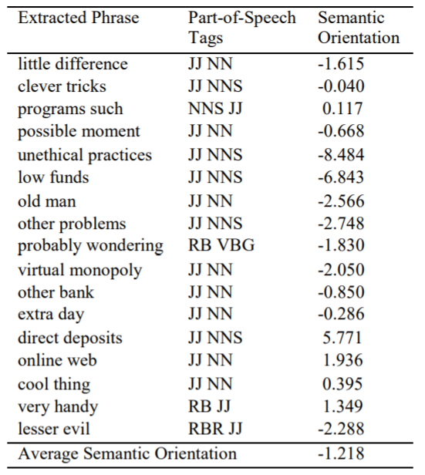
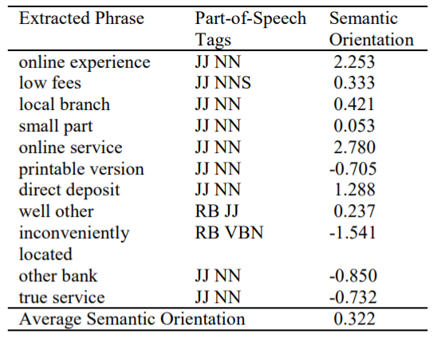
Applying POS Bigrams for Opinion Mining
Processing of a review where author
summarized as “recommended”
Processing of a review where author
summarized as “not recommended”

Slide 22
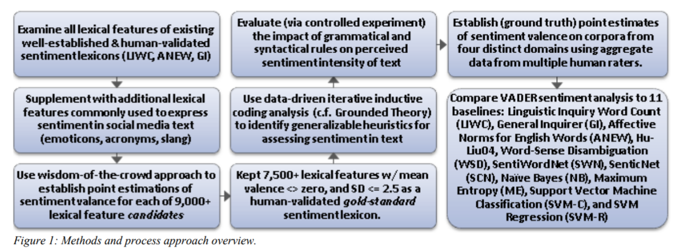
Valence Aware Dictionary for sEntiment Reasoning (VADER)
A popular tool for unsupervised sentiment analysis
Available in Python
Source: Hutto & Gilbert 2014

Slide 23
Adds Human Heuristics for Expressing Sentiments
Punctuation, e.g., ! increases the sentiment intensity
Capitalization, e.g., ALL-CAPS
Degree modifiers, e.g., “The service here is extremely good”
Sentiment shifters, e.g., “The food here is great, but the service is horrible”
Trigram preceding a sentiment-laden lexical feature: Catch nearly 90% of cases where negation flips the polarity of the text.
E.g., “The food here isn’t really all that great”.
Source: Hutto & Gilbert 2014

Slide 24
Multiple Products, Multiple Attributes
“The lobby of the Coastal Delight was cool, but the room was nothing to write home about; the food was good, but the location was too far away from public transportation. In hindsight, although the Tuscany Grand was very pricey, its awesome location and high-end ambience would have been great.”
Assumption: People express emotions in close proximity to the mentions of entities and/or attributes.
Parse and extract phrases that are “relevant”
E.g., Dell & warranty, hotel & lobby, etc.
Then pass through a sentiment analyzer like VADER

